Slide 1
Flux and Redux
Jason Monroe - 688776

Slide 2
Course Objective:
At the end this 150 min session, you will be able to
Implement Redux in a React Application

Slide 3
Benefits of Redux
Simplifies state handling
Reduces complexity of components
Most popular form of Flux

Slide 4
Key Topics
Overview
Actions
Reducers
Stores
Dispatching
React Implementation

Slide 5
Overview

Slide 6
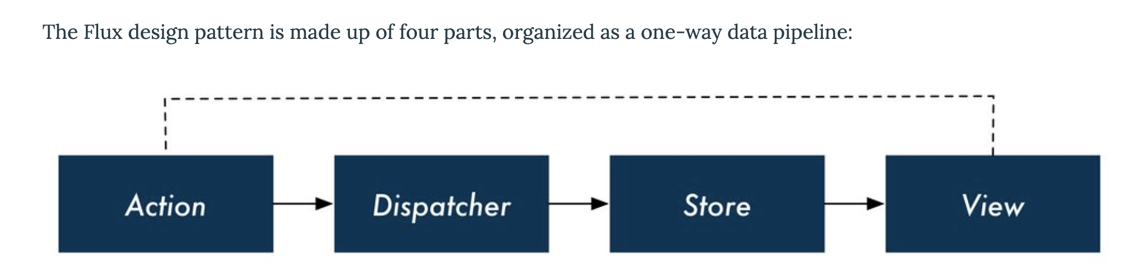
What is Flux?
https://www.newline.co/fullstack-react/p/intro-to-flux-and-redux/

Slide 7
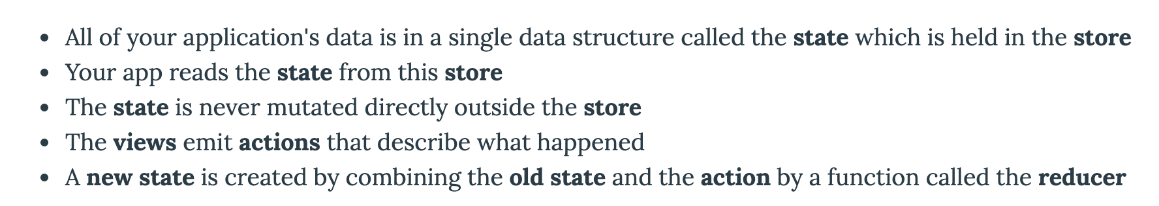
What is Redux?
https://www.newline.co/fullstack-react/p/intro-to-flux-and-redux/

Slide 8
Actions, Reducers, and Store

Slide 9
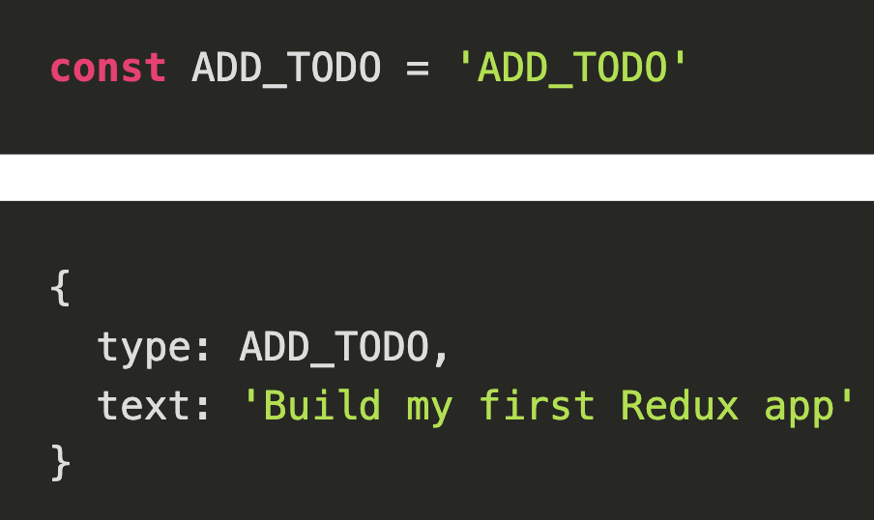
What is an Action?
An Object with a type attribute that is typically a string and other attributes made up of data
Like a verb along with a payload
https://redux.js.org/basics/actions

Slide 10
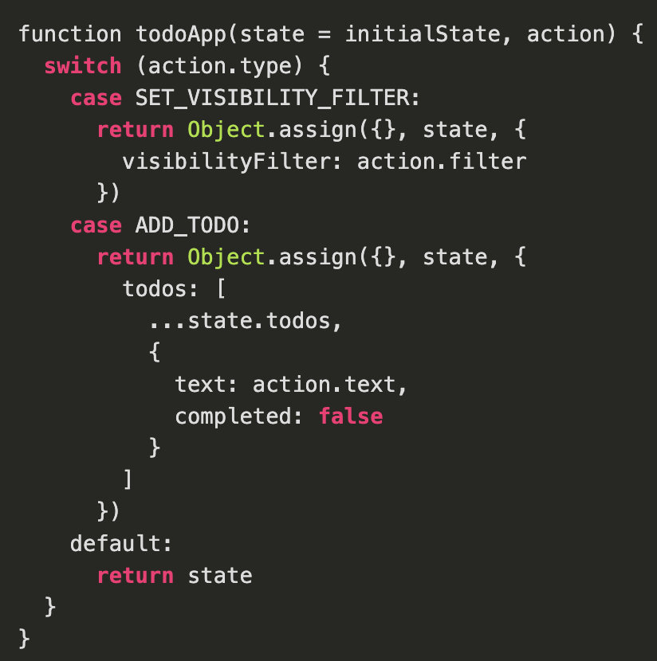
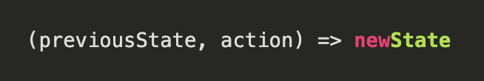
What is a Reducer?
A function that receives the previousState and an action and then outputs the new state
Contains logic on how to update the state
https://redux.js.org/basics/actions

Slide 11
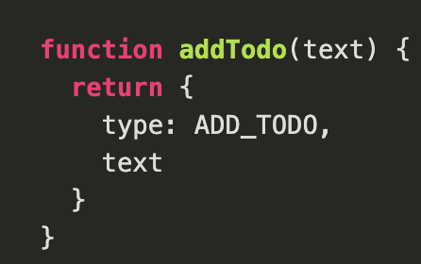
What is an Action Creator?
A method that returns the appropriate action object. Abstracts Action object out of program logic
Makes them portable and testable
https://redux.js.org/basics/actions#action-creators

Slide 12
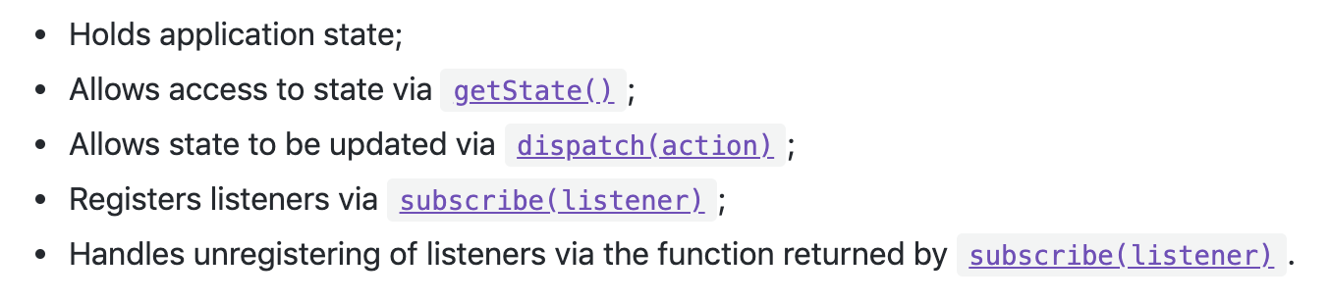
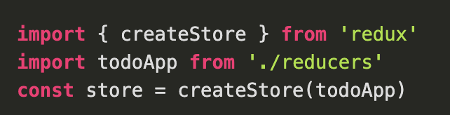
What is the Store

Slide 13
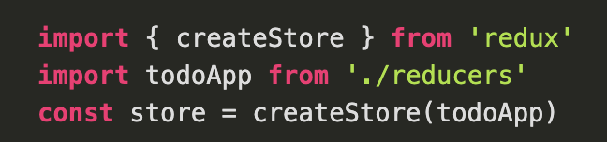
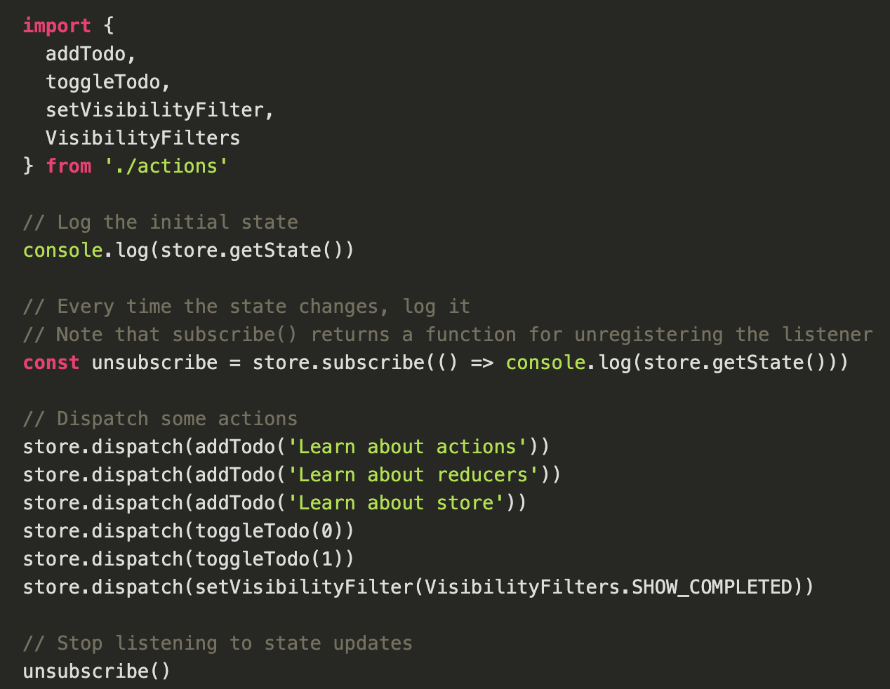
Dispatching an Action
Make a call to an action creator method, passing it the action
Pass that call as the argument to store.dispatch()

Slide 14
Redux and React

Slide 15
Installation
Yarn add redux OR npm install redux
Yarn add react-redux OR npm install react-redux
Yarn add redux-actions OR npm install redux-actions

Slide 16
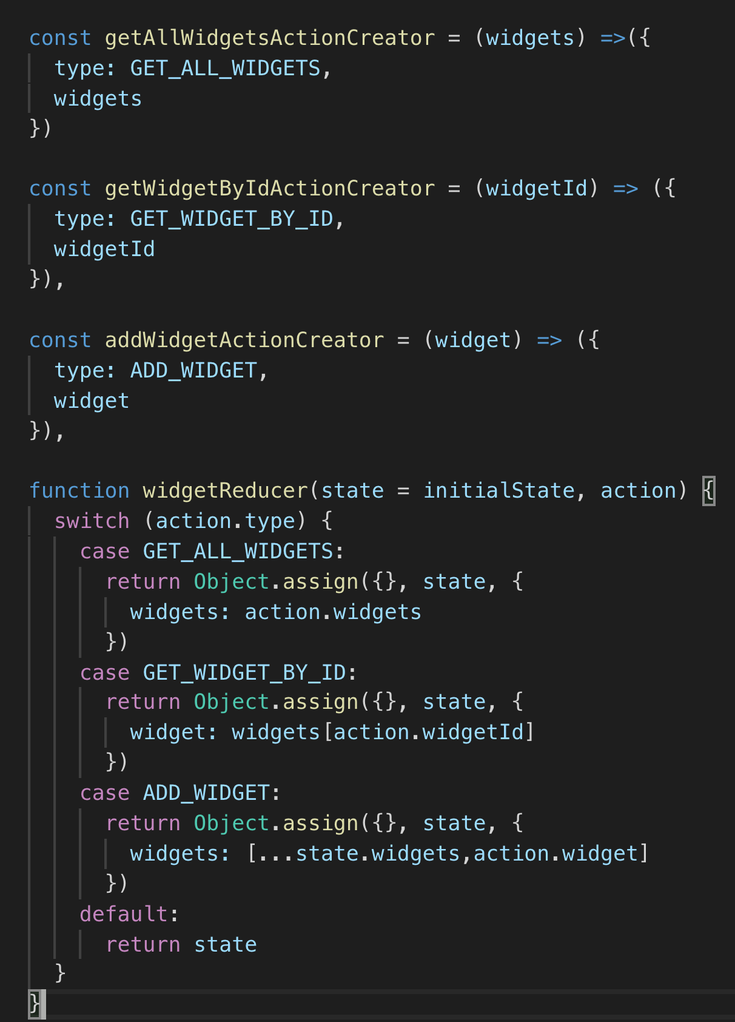
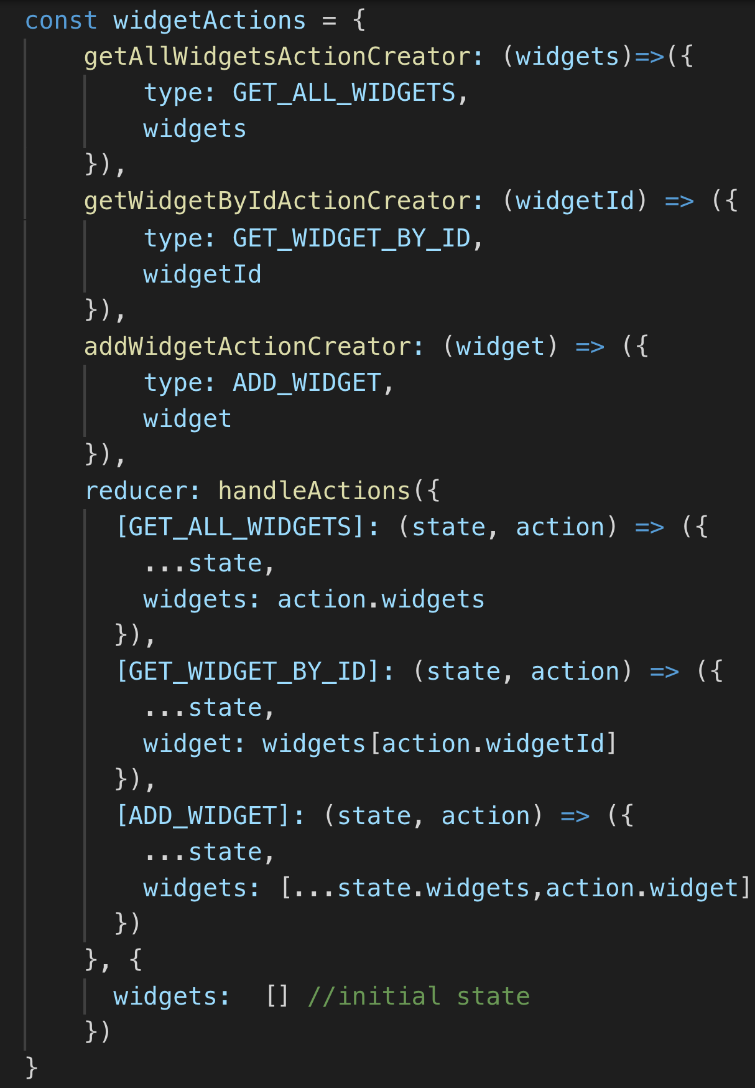
Actions and Reducers using Redux-Actions
Notes:
Switch/case is considered an antipattern. Use a robust object instead

Slide 17
Actions and Reducers using Redux-Actions
Single object with action creators and reducers
Action creators can be called by accessing the appropriate property
Reducer property bundles reducers as a single object
https://redux-actions.js.org/introduction/tutorial

Slide 18
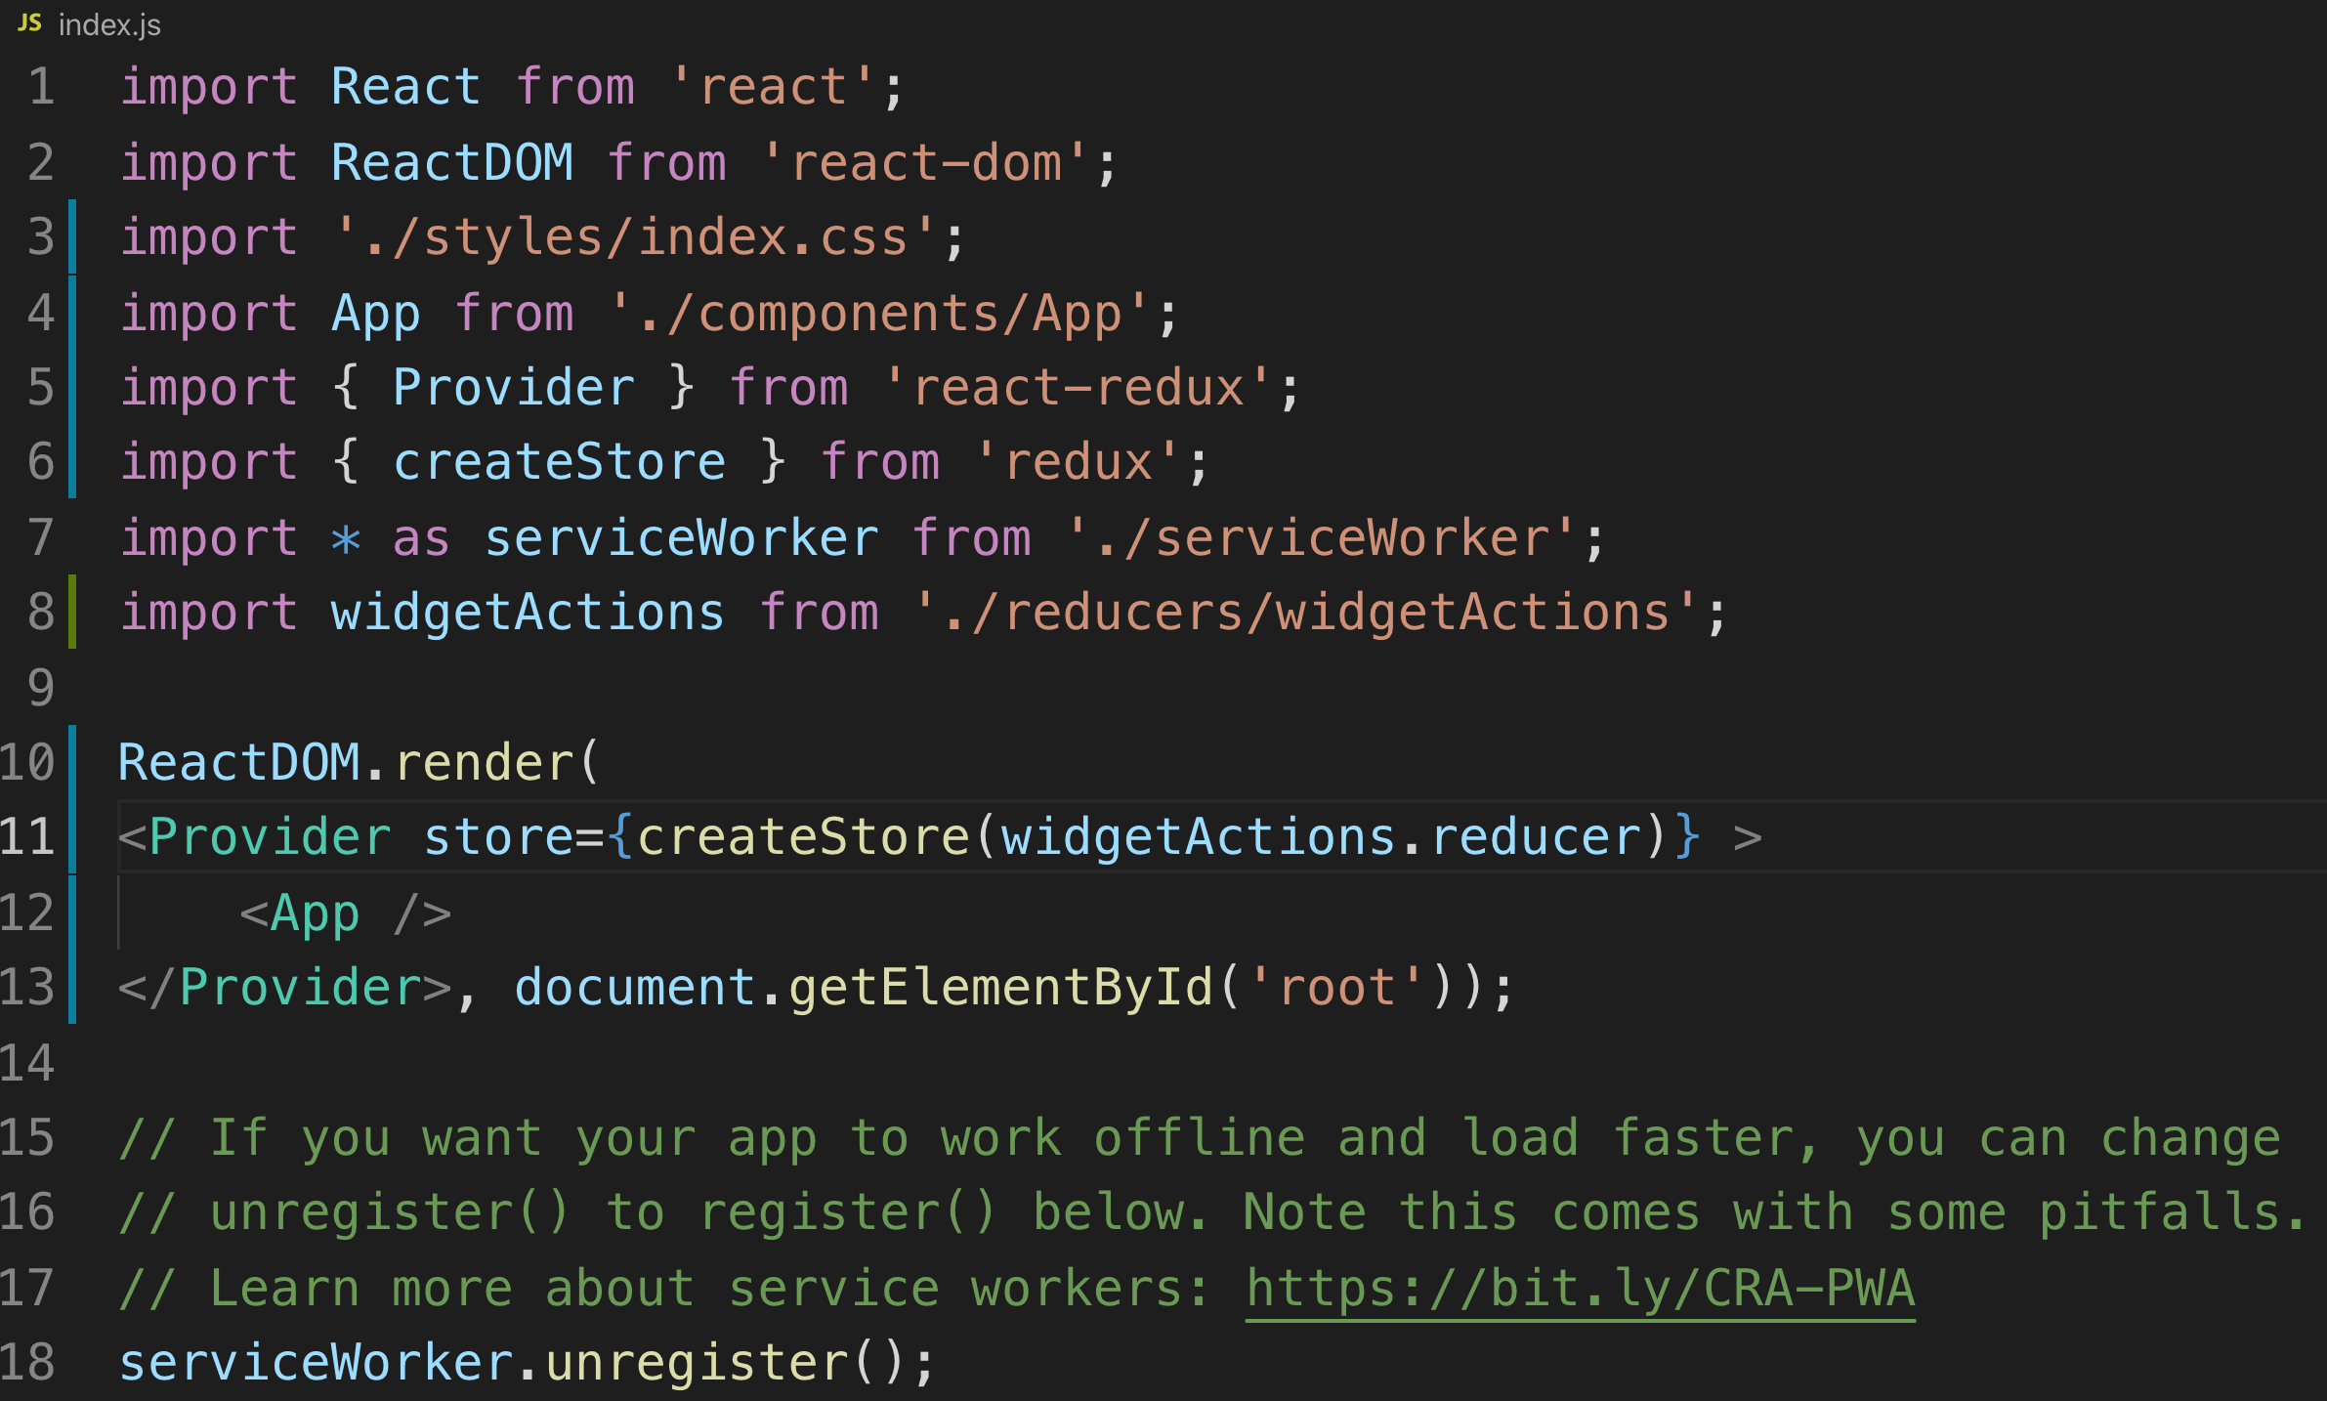
Creating Store and Providing to App
Do this in index.js
Provider tag wraps <App /> and makes store available to entire app
reducer property from robust object

Slide 19
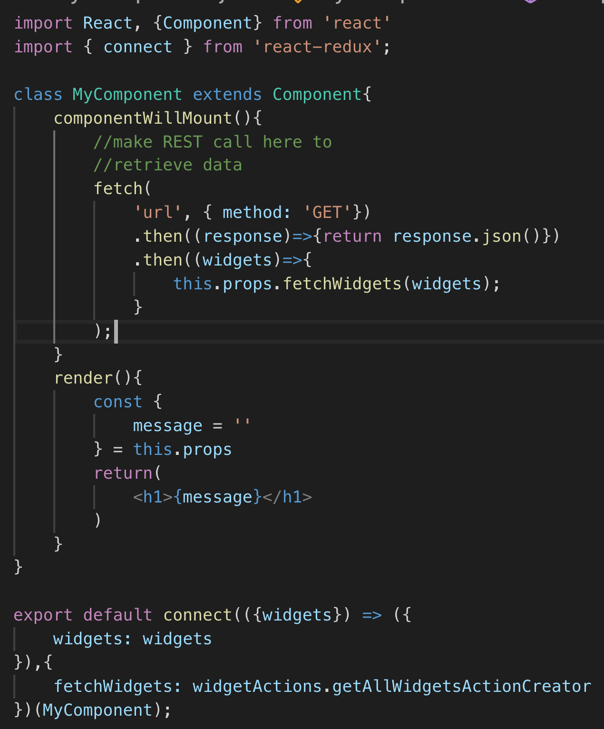
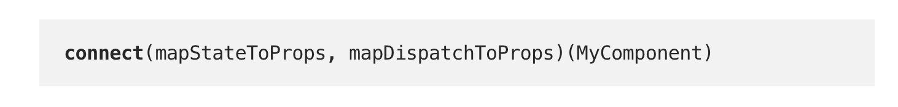
Connect Component to Store
import connect from ‘react-redux’
Access store in a lifecycle method, calling actionCreator
Connect method call on export injecting dispatch and exposing actionCreator to component
https://blog.benestudio.co/5-ways-to-connect-redux-actions-3f56af4009c8
https://javascript.info/currying-partials

Slide 20

Code Along Practice – Converting hello-react to Redux
Install redux, react-redux, redux-actions
Reorganize project structure into components, models, reducers and tests folders
Create reducer and action creator for getAllDevelopers and using handleActions from react-actions
Create store and provider for app
Connect App.js component to store, accessing its getAllDevelopers action creator on componentDidMount
Add reducer and action creator for addDevelopers
Connect AddDevelopers component to store, accessing its addDevelopers

Slide 21
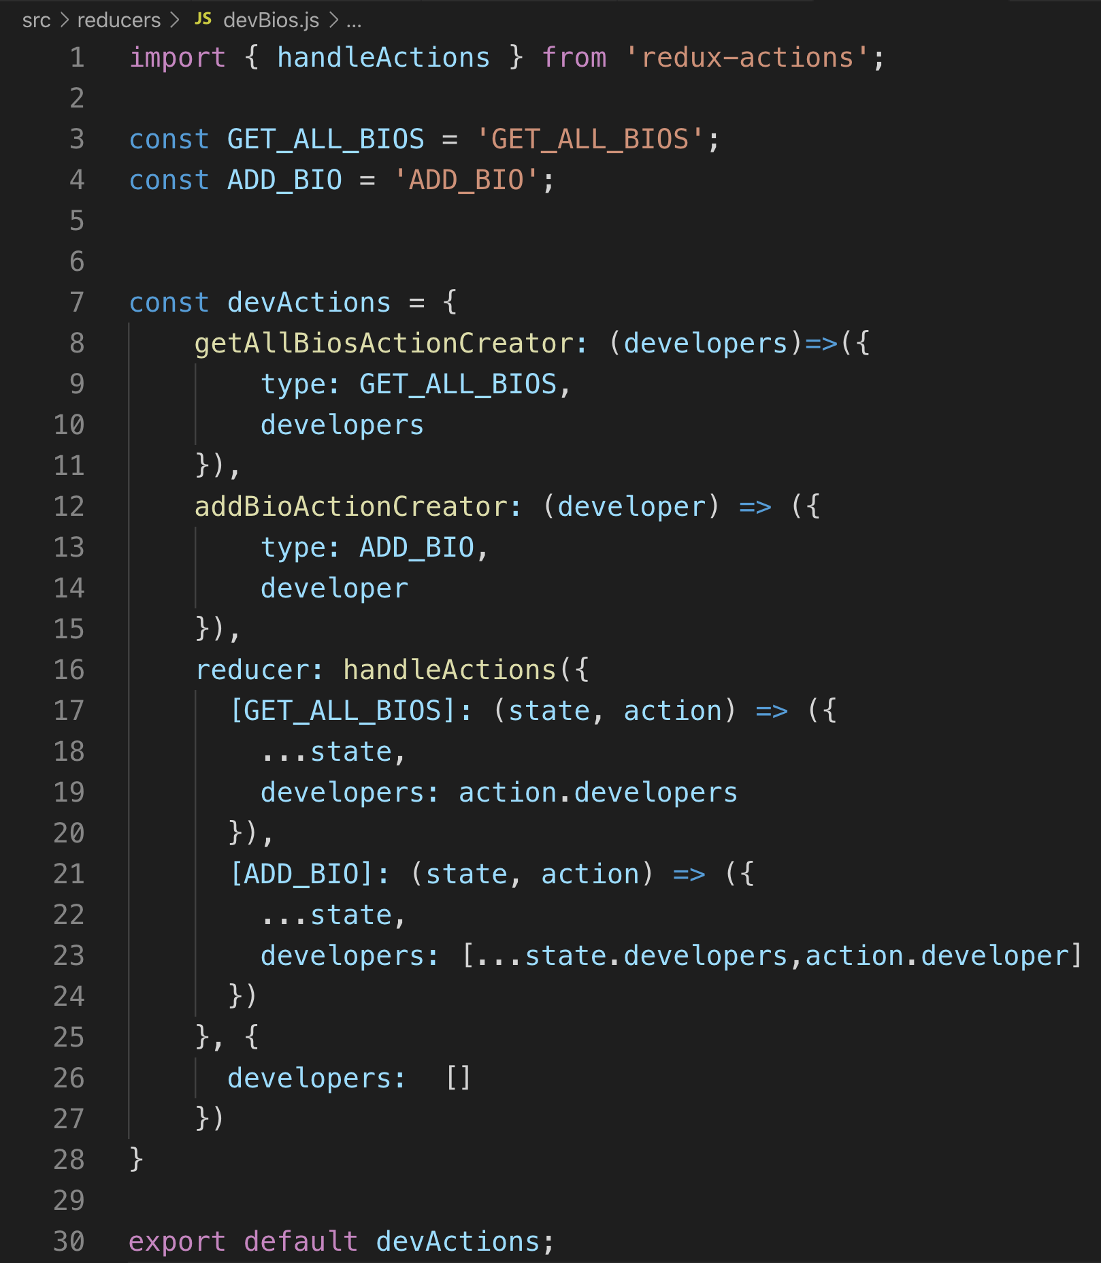
devBios.js

Slide 22
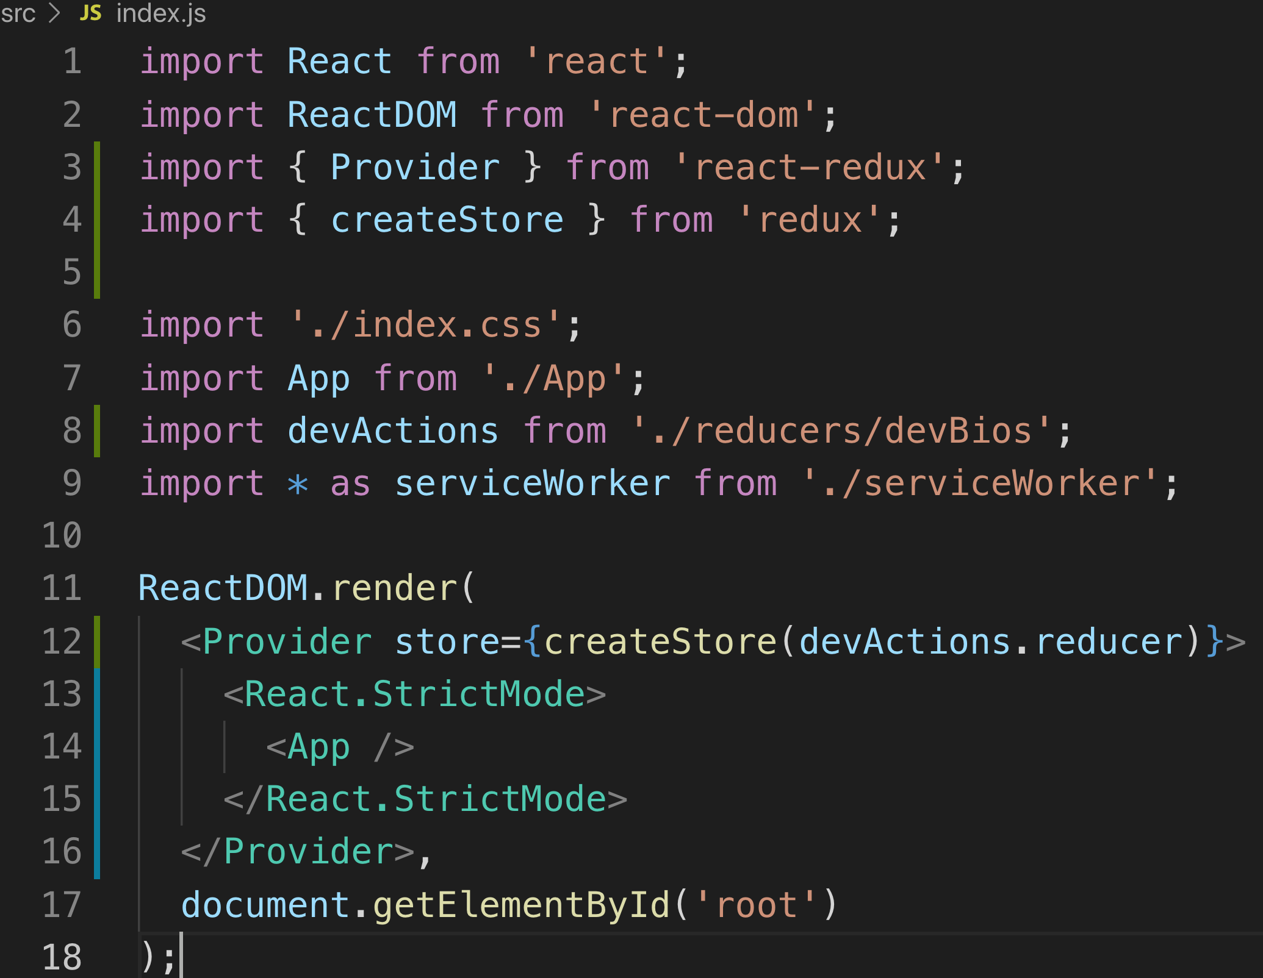
index.js

Slide 23
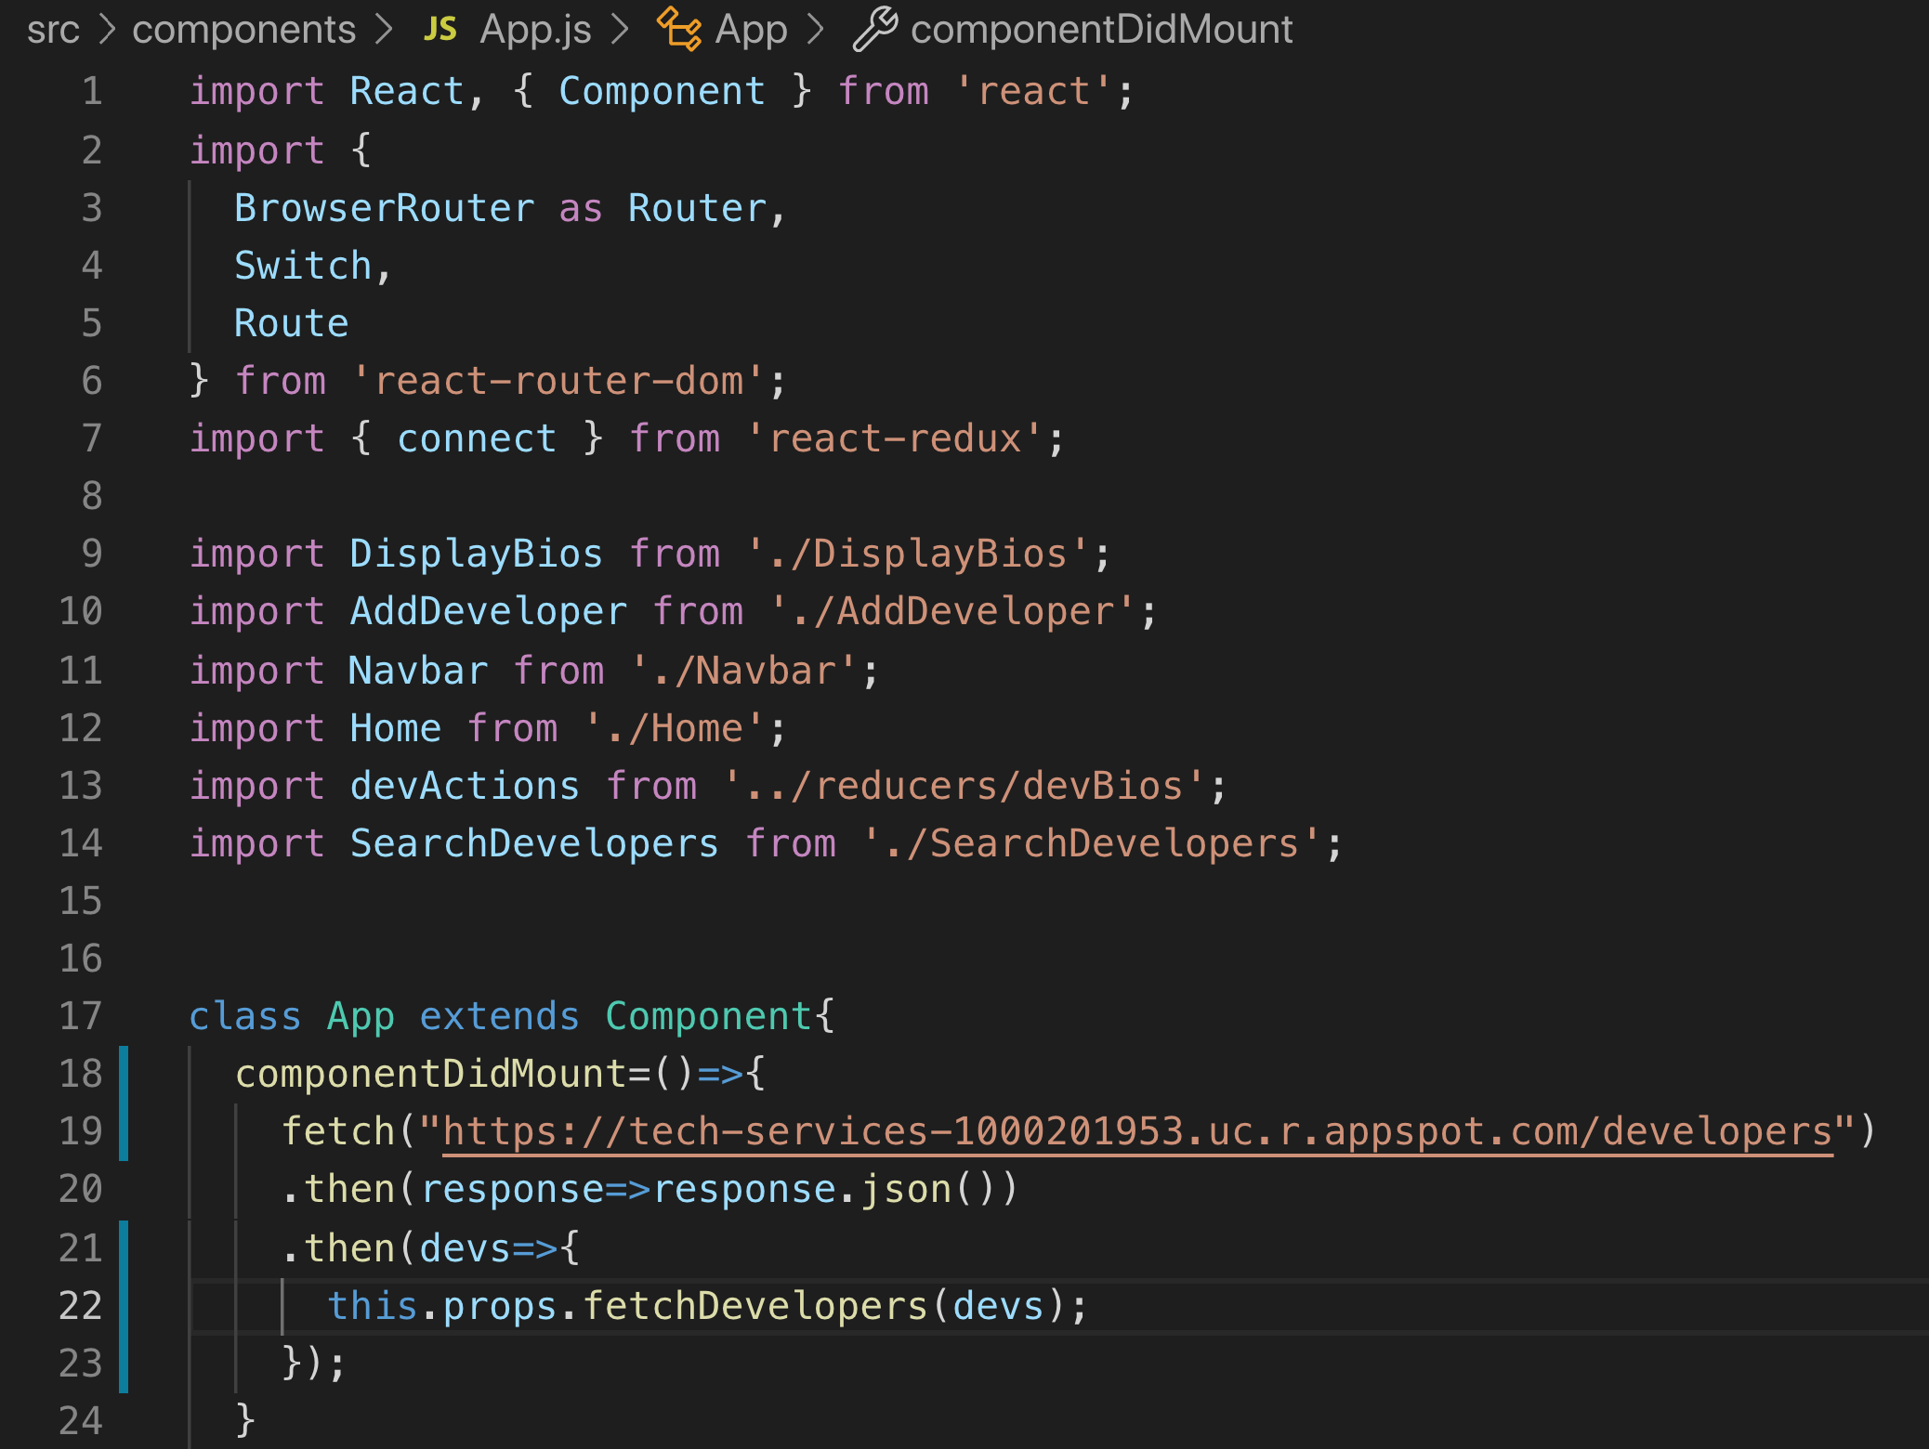
App.js

Slide 24
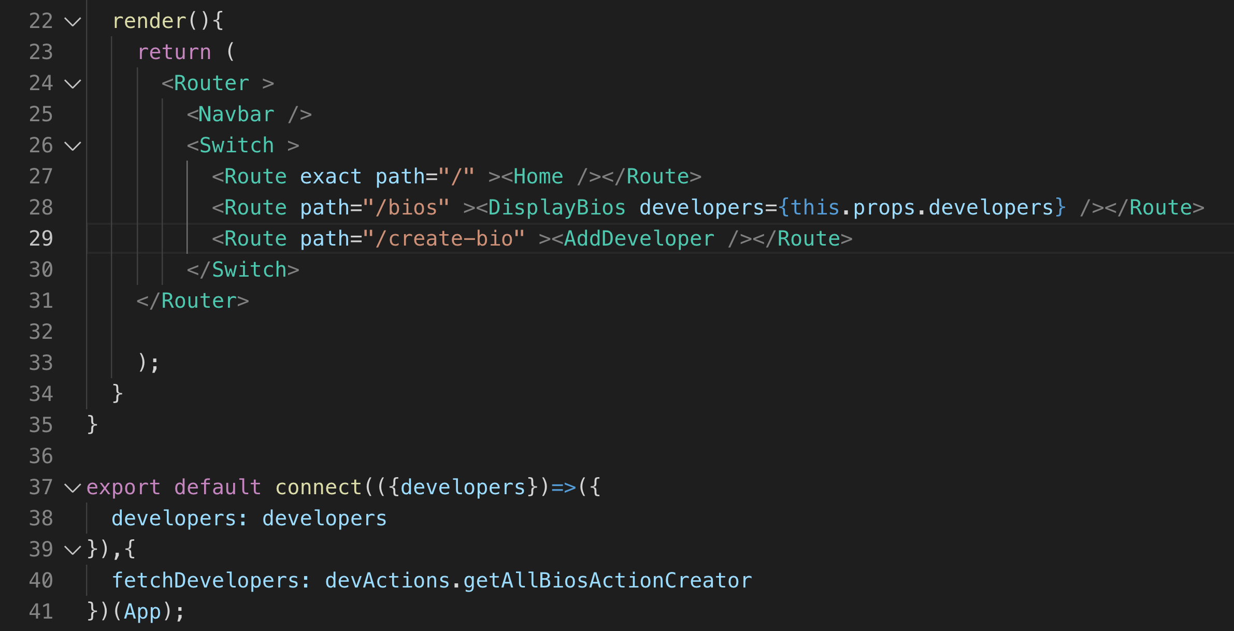
App.js

Slide 25
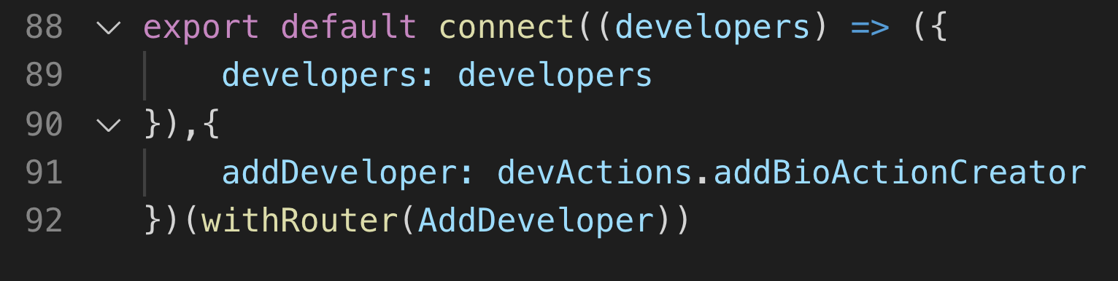
AddDeveloper.js (partial)

Slide 26
On Your Own

Slide 27
On Your Own
Convert your Todos-React project into a React-Redux project.
Create Todos action creators and reducer for Add, Edit, and Delete
Create a store with those reducers and provide it to app
Connect components and call action creators from lifecycle methods

Slide 28
Review
Actions
Reducers
Stores
Provider
Connect

Slide 29
Course Objective:
At the end this 150 min session, you will be able to
Implement Redux in a React application

Slide 30
Why wouldn’t an app use Redux?
How difficult was it to convert to Redux?

Slide 31
Thank You

